Slide 1
WEB DEVELOPMENT
ACTIVITY-BASED LEARNING (ABL) REPORT
Submitted by
N . Durga Sai
Roll Number: 26000966 Branch and Section: CSM / 2 Course: Web Development
Dr. RVR NRI Institute of Technology
Project Titles
1. Electronic Store Website
2. Bus and Train Ticket Booking Interface
3. Online Food Ordering Website

Slide 2
















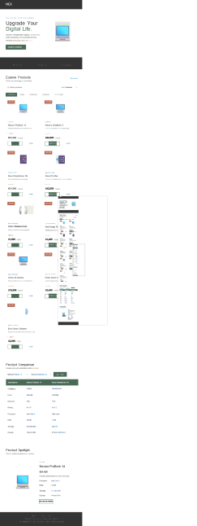

N EX
T H E F U T U R E I S I N Y D U R H A N D S
Upgrade Your
Digital Life.
Discover next-generation laptops, smartphones, smart accessories and connected devices.
Premium technology all in one place.
Explore Collection
Explore Products
Find the right technology for your lifestyle.
9 products
Q, Search products.
Sort. Featured
•
Laptops
Smartphones
Accessories
Smart Devices
L A P 7 O P
LA PT O P
Nexora ProBook 14
Powerful performance for work and study.
hlexora UltraBook X
Premium productivity v/ith a sleek design
* 4815
€64,999
> 4.7 / 5
Details
€82,999
Details
SMARTPHONE
S ki A RT P H O NE
Nova Smartphone 5G
Fast connectivity and vivid visuals.
hlova Pro Max
A premium smartphone for everyday creators
+ 4.6 / S
> 4.9 / 5
€24,999
Details
€42,999
Details
A CC E 5 SO R I E S
A C C E S S O R I E S
Sonic Wireless Buds
Enjoy your favourite music wirelessly.
hlexCharge Power Bank
Portable power for your daily adventures
*4515
€1,999
> 4.4 / 5
Details
€1,499
Details
A CC E 5 SO R I E S
S ki A R T D E V I C E
Vision 4K Monitor
Sharper detail for work and entertainment.
Pulse Smart Watch
Useful everyday features on your wrist
+ 4.6 / S
*4.5/5
€3,499
€18,999
Details
Details
SM A R 7 DE VI C E
Echo Smart Speaker
Bring music and smart features into your room
* 4315
€2,999
Details
Product Comparison
Compare prices and specifications before choosing
Nexora ProBook 14
Nova Smartphone 50 •
one re Not
Specificati on | Nexo ra ProBook 14 | Nova 5martpho ne VG
CaMgoq | Laptop | Smartphone
Price | 764,999 | Z24,999
Discount | 13% | 17%
Rating | 4 8 / 5 | 4.6 / 5
Processor | Intel Core i5 | Octa—core
RAM | 16 GB | 8 GB
Storage | 512 GB SSD | 256 GB
Display | 14inch FHD | 6.7-inch AMOLED
Product Spotlight
Discover detailed specifications and features.
L A P 7 O P
Nexora ProBook 14
€64,999
Powerful performance for work and study
Processor Intel Core i5 RAM 16 GB
Storage 512 GB SSD
Display 14-inch FHD
Ad d ro C an

Slide 3
















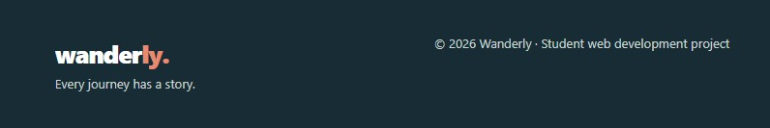
Book tickets
Our services My booking
Your next journey
starts here.
D iscc .’e bea rim fr‹Iyou rne}’s com pa ie fares choose your sea I, and make
e\°.r m e memorable.
FROM
TO
vjayawada
Hyderabad
JOURN EY DATE
@
PAS SENGERS
20-10 -2026
4 Passengers
Journeys made for you
Explore your travel options and find the right ride.
All services
W AC
Sleeper
Coastal Comfort
Non-AC Sleeper Sleeper Reading light
21:00
Vi'a a\•zada
7h 30m
Hyd eraBad
per passenger demo fare
Se4eW service
Sunrise Express
AC Seater
AC Reclining seats
as:oo
Vijaya\•zada
6h 30m
14:30
Hyd eraBad
per passenger demo fare
Se4eW service
GreenLine Travels
AC Sleeper
AC Sleeper Charging point
Vi'a a\•zada
6h 00m
12:30
Hyd eraBad
per passenger demo fare
Se4eW service
The Wanderly difference
Thoug htfuI features for a smoother journey.
Travel your way
Compare different services and choose what works for your plans.
Simple seat selection
View seat layouD and select your preferred available seats
Clear fare summary
Review your estimated total before confirming your demo booking.
Complete your journey
Choose a service first, then add passenger details.
Sunrise Express Vjayawada -+ Hyderabad
Bus AC Seater 2O26-10—20
Passenger details
FULL NAME
EMAIL ADDRES S
Enter passenger name
you@example.com
MOBI LE NUMB ER
PAS SENGER AGE
10-digit mobile number
Age
Choose your seats
Select the number of seats matching your passenger count.
S3
SS
S6
S8
S9
510 511 512
513 514 515 516
Avail able
Selected
Unavaila ble

Slide 4

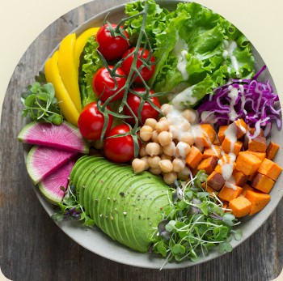

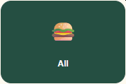








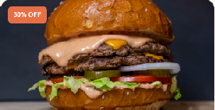



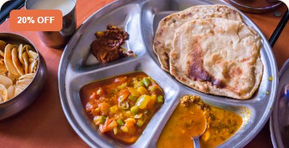

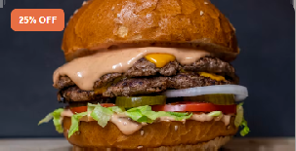



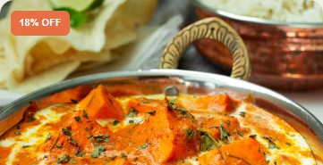



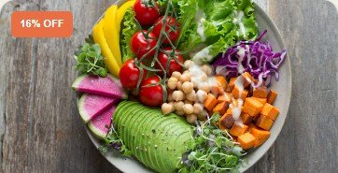
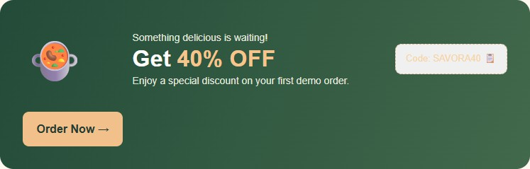



SAVORA
TA ST E T H E MOM EN T
Home Restaurants Menu Offers Reviews Searchfood
C R A V I N G S 0 M E T H I N G D E L I C I O U S ?
Good Food. Delivered Fresh.
Discover delicious meals explore favourite restaurants and enjoy every bite delivered to your doorstep.
f 1 Search your favourite f.
t Fast Delivery C Fresh & 3bsty
30—4S min Made with care
v Easy Ordering
Simple 6 convenient
 | Find Food
F O0 D C AT E G 0 R TE S
What Would You Like to Eat?
Choose your cravings and explore our menu.
Burgers
Pizza
Indian
Chinese
Drinks
Healthy
M A D E F O R F 0 O D L0 V E R 5
Popular Restaurants
Explore local favourites and customer-loved places.
Burger House
w Burgers American
> 4.5
Juicy burgers, golden fries and delicious flavours.
25—35 min
Pizza Planet
a, Italian Pizza
A 4.7
30-40 min
Explore Idenu
Freshly baked pizzas loaded wilti delicious toppings.
Explore Idenu
Spice Villa
p Indian Biryani
A 4.8
35-45 min f
Sweet Comer
a DesseM Bakery
4.6
20—30 min
Authentic Indian meak prepared with care.
Sweet treats and delightful desserts for every mood.
Explore Idenu
Explore Idenu
FR E S H F R O M 0 U R K TT C H E N
Our Delicious Menu
Find your favourite dish and add it to your cart.
@ Search dishes or restaurants..
Sort. Recommended •
gs Classic Veg Burger
Burger House Burger
a Margherita Pizza
Pizza Planet Pizza
Crispy patty, fresh lettuce and creamy sauce.
Classic cheese pizza vmlti fresh
f 4.5
a 20 min
A 4.7
a 30 min
4'149
4'249
Delicious Food
Paneer Butter Masala
Spice Villa Indian
Soft paneer in a rich, creamy tomato gravy
Veg Biryani
Spice Villa Indian
Fragrant rice cooked vmlti spices and vegetables.
A 4.8
a 30 min f
4.6
a 25 min
4'229
4'179
Hakka Noodles
Wok Garden Chinese
, Chocolate Cake
Sweet Comer Dessert
Rich chocolate layers vmlti smooth Irosling.
Wok-tossed noodles with crunchy vegetables.
f 4.4
a 25 min
f 4.9
a 20 min
7169
4'129
j• Mango Smoothie
Fresh Sips Beverage
A refreshing fruit drink with mango flavour
@ Garden Fresh Salad
Green Bovd Healthy
f 4.5
a 15 min f
Fresh greens. colourful vegetables and seeds.
4'99
4.6
a 15 min
4'159
WO R D S F R O M 0 U R C U S T O M E R S
What Food Lovers Say
Happy customers maKe every meal more special.
Priya Sharma
Verified demo review
****4.8
Rohit Verma
Verified demo review
Sneha Patei
Verifled demo review
"Amazing food and a lovely
ordering The
flavours were wonderful!"
"A great variety of dishes and a simple Finding my favourite food was easy."
*** 49
"Beautiful design, tempting food
pictures and a very convenient
SAVOR
Expl o e
C uszorr e r Ca re

Slide 5
1. Electronic Store Website
The Electronic Store Website provides a clear and user-friendly way to explore electronic products, view product details, compare specifications, and add items to a cart. Its product categories, pricing, discounts, and comparison section help users make informed choices. This activity demonstrates how a well-organized interface can improve product discovery and the online shopping experience.
2. Bus and Train Ticket Booking Interface
The Bus and Train Ticket Booking Interface allows users to choose a travel mode, enter origin and destination details, select a journey date and passenger count, and review available services and fares. The passenger-details and seat-selection sections illustrate the main stages of a booking process. This activity highlights how structured forms and clear fare summaries can make travel planning easier and more understandable.
3. Online Food Ordering Website
The Online Food Ordering Website presents food categories, restaurant options, menu items, prices, ratings, and add-to-cart controls in an accessible layout. These features help customers browse meals and select items conveniently. The activity demonstrates the importance of visual presentation, clear menu information, and a simple ordering flow in a food delivery interface

